Slide 1


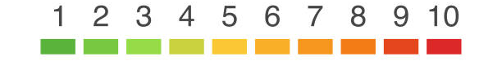

DeepCache Implementation
Problem Statement
Expectations
Context
Undertaken Tasks
Conduct Literature survey.
Implement DeepCache.
Identify whether LoRA technique post DeepCache implementation is feasible and helps in getting more inference time.
DeepCache helps improve inference speed of Stable Diffusion model. It does this by skipping few steps in U-Net during inference. The results are faster with very little degradation in quality. We can have this worklet to compare this method as well as combining this with other methods to improve inference speed of SD.
KPI
DeepCache implementation
Inference speed should have at least 25% improvement for similar prompt on vanilla Stable Diffusion model.
LoRA implementation.
Statement
Implement DeepCache on latest Stable Diffusion model.
Worklet Details
Mentors
Pranal Prasad Dongare
+91-7022250561
pranal.p@samsung.com
6
4
Timeline
Tushar Madaan
+91-9205301569
Tushar.m2@samsung.com
Kick Off < 1st Month >
Milestone 1 < 3rd Month >
Milestone 2 < 6th Month>
Duration (Months)
Members Count
Problem Briefing
Check Feasibility
Literature Survey
LLM Setup
Initial implementation of architecture.
Initial benchmarking of performance.
Optimization and enhancement of implemented model.
Pre-Requisite
2312.00858.pdf (arxiv.org)
Complexity
Notes:
https://nv-tlabs.github.io/DIB-R/

